Slide 1
Workflow to develop DATEX II
Data Exchange System
Virtual DATEX II User Forum - Developer Session
Jan Vlčinský - TamTam Research s.r.o.

Slide 2
DATEX II
Data Exchange System

Slide 4
Workflow to develop
Data Structures

Slide 5
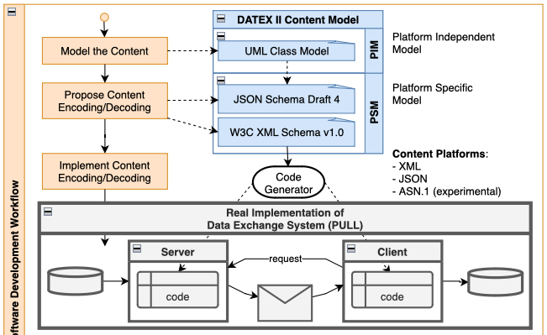

Slide 6
Workflow to develop
Protocol

Slide 7
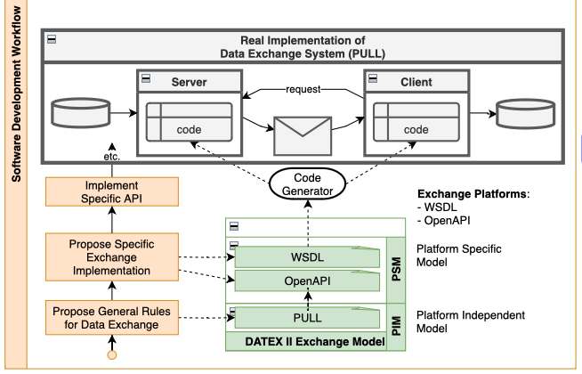

Slide 8
PIM and PSM
Platform Independent Model
&
Platform Specific Model

Slide 9
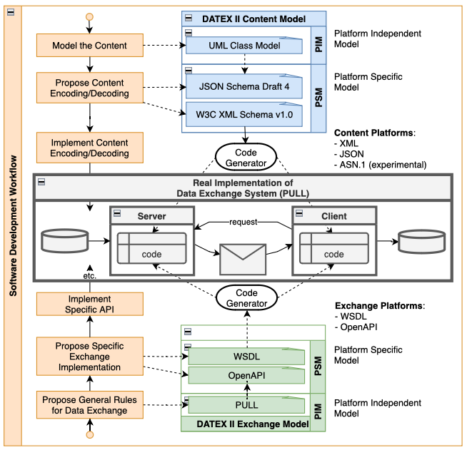

Slide 10
Time to get Practical
1. Generate JSON Schema
2. Code real systems
in multiple
programming languages

Slide 11
Create Class Model &
(JSON) Schema for
DATEX II Content
Virtual DATEX II User Forum - Developer Session
Jan Vlčinský - TamTam Research s.r.o.

Slide 12
The Plan
Visit DATEX II Class Model Library
Slim down the Model
Generate (JSON) Schema

Slide 13
Entering a Shopping Mall:
Safer and Smarter
With a Shopping List in Hand

Slide 14
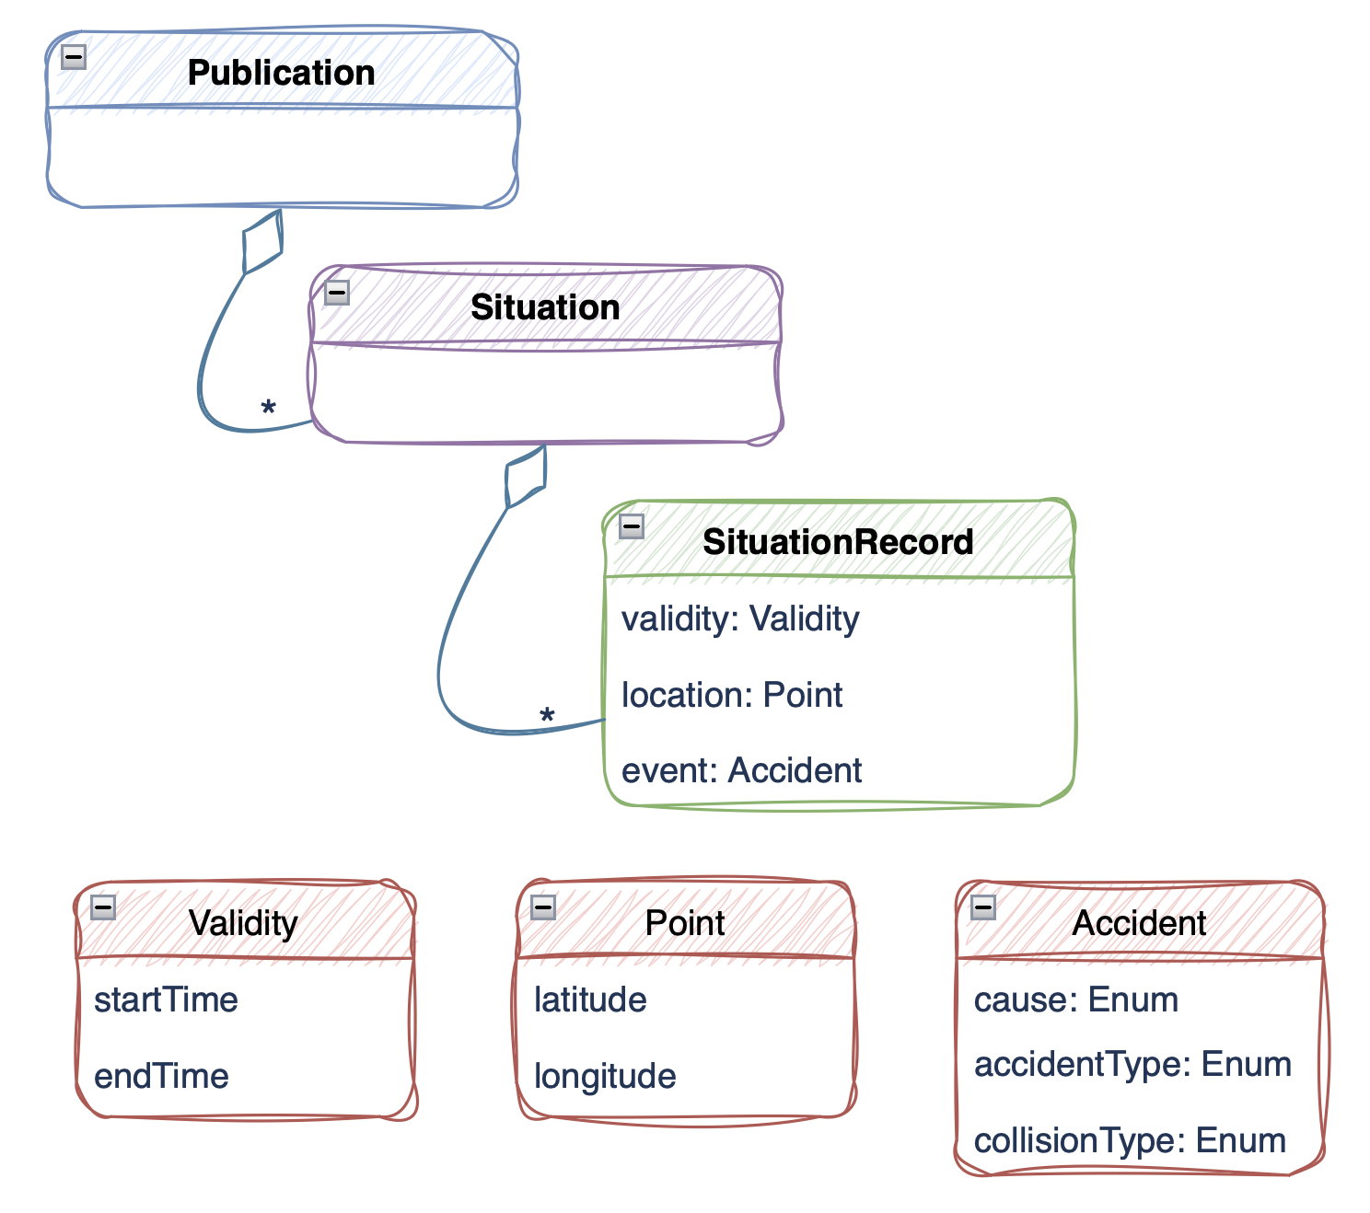

Slide 15
DATEX II Class Model
HTML Browsable documentation:
https://docs.datex2.eu
-> Download current version -> DATEX II Version 3.4
-> HTML Model of DATEX II v3.4
-> HTML UML Model v3.4 (browsable version):
https://docs.datex2.eu/_static/data/v3.4/umlmodel/html/index.htm
-> Payload Publication -> PayloadPublication classes (diagram) -> SituationPublication -> Situation -> … hunt for Accident

Slide 16
WebTool - Concepts

Slide 17
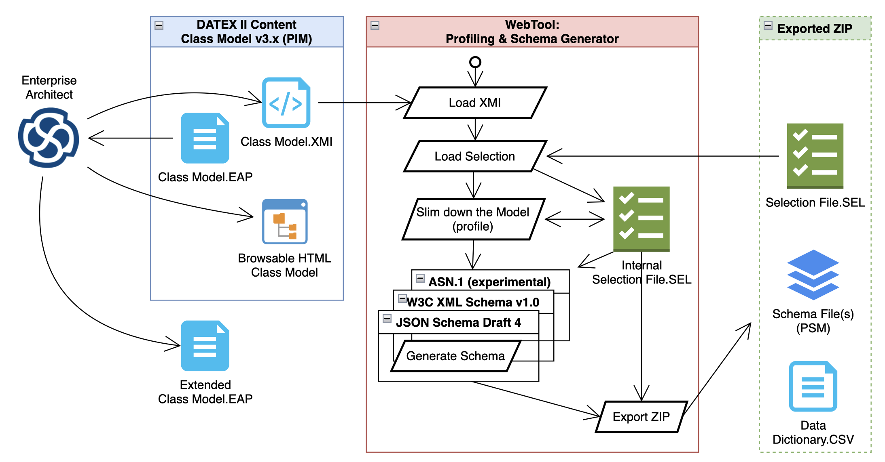

Slide 18
WebTool - Show Time
http://webtool.datex2.eu

Slide 19
(JSON) Schema Files

Slide 20
Thank You
Jan Vlčinský
jan.vlcinsky@tamtamresearch.com

